Slide 1
React Forms

Slide 2
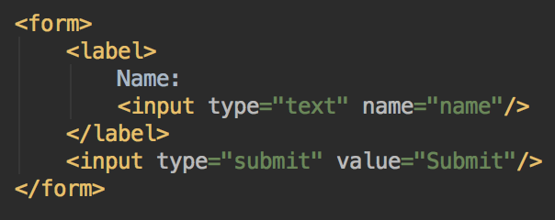
Forms
HTML form elements work a little bit differently from other DOM elements in React, because form elements naturally keep some internal state. For example, this form in plain HTML accepts a single name:
Notes:
This form has the default HTML form behavior of browsing to a new page when the user submits the form. If you want this behavior in React, it just works. But in most cases, it’s convenient to have a JavaScript function that handles the submission of the form and has access to the data that the user entered into the form. The standard way to achieve this is with a technique called “controlled components”.
Since the value attribute is set on our form element, the displayed value will always be this.state.value, making the React state the source of truth. Since handleChange runs on every keystroke to update the React state, the displayed value will update as the user types.

Slide 3
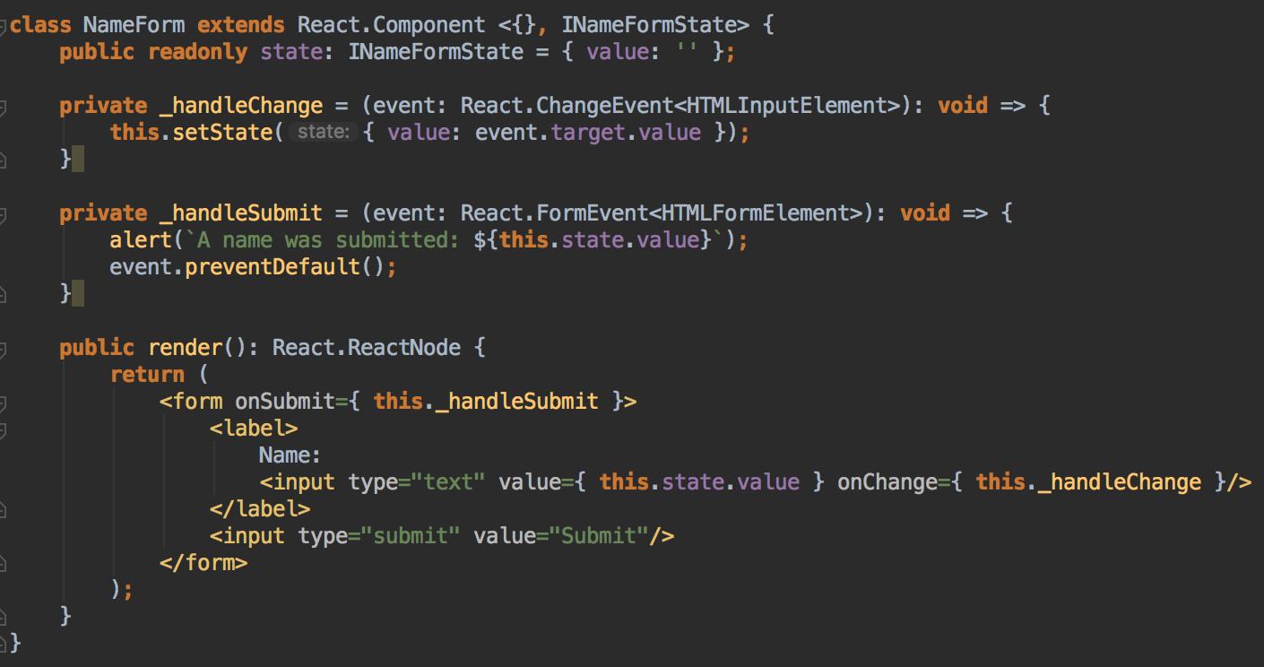
Controlled Components
Notes:
In HTML, form elements such as <input>, <textarea>, and <select> typically maintain their own state and update it based on user input. In React, mutable state is typically kept in the state property of components, and only updated with setState().
We can combine the two by making the React state be the “single source of truth”. Then the React component that renders a form also controls what happens in that form on subsequent user input. An input form element whose value is controlled by React in this way is called a “controlled component”.
Since the value attribute is set on our form element, the displayed value will always be this.state.value, making the React state the source of truth. Since _handleChange runs on every keystroke to update the React state, the displayed value will update as the user types.

Slide 4
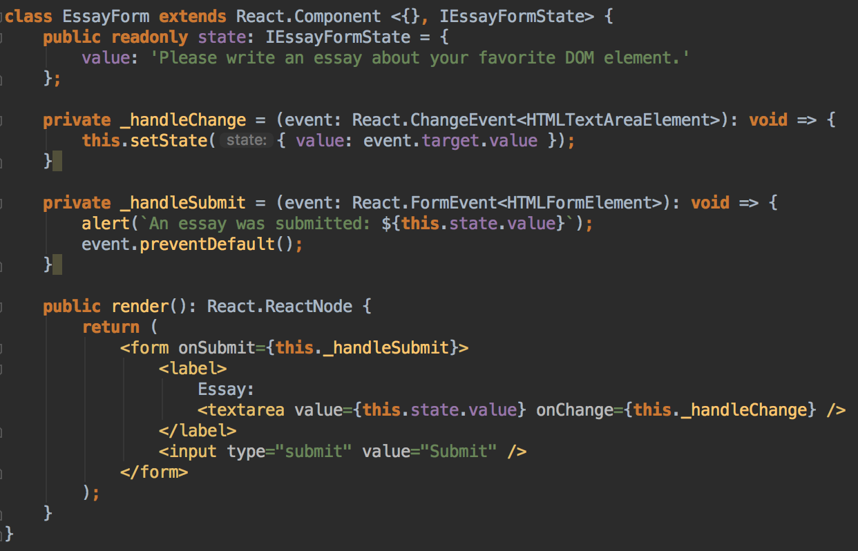
The textarea Tag
Notes:
In HTML, a <textarea> element defines its text by its children. In React, a <textarea> uses a value attribute instead. This way, a form using a <textarea> can be written very similarly to a form that uses a single-line input. Notice that this.state.value is initialized, so that the text area starts off with some text in it.

Slide 5
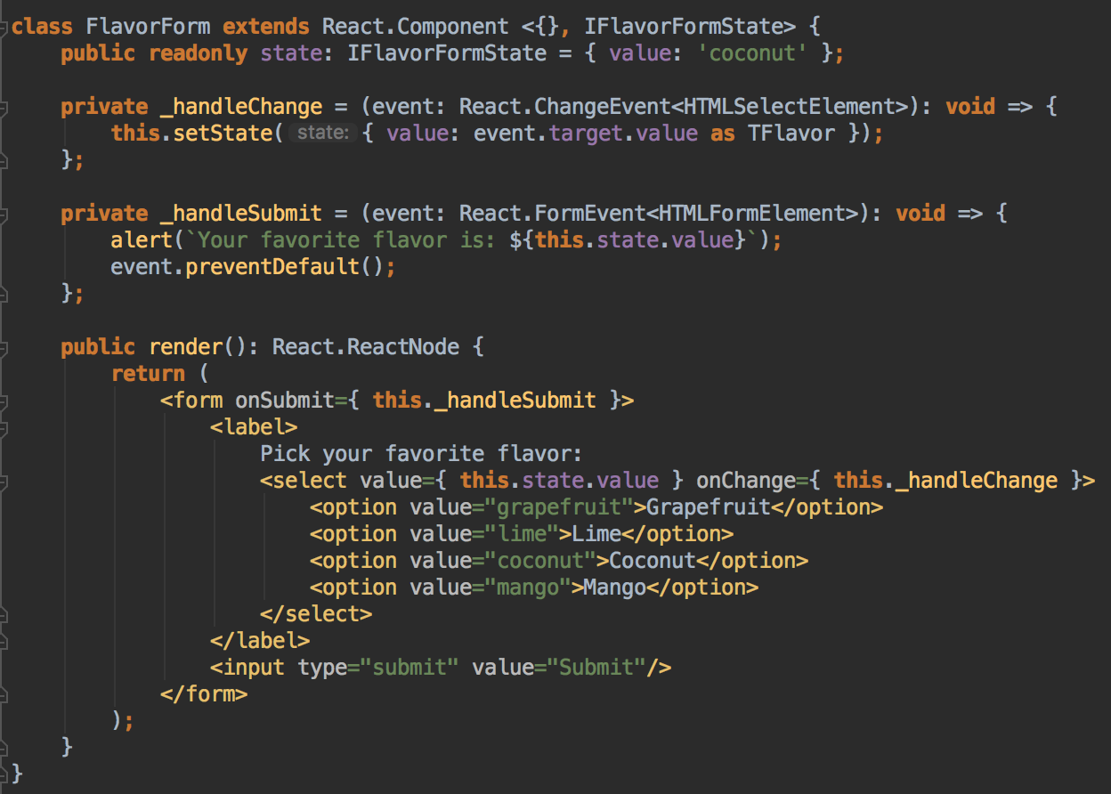
The select Tag
Notes:
Overall, this makes it so that <input type="text">, <textarea>, and <select> all work very similarly - they all accept a value attribute that you can use to implement a controlled component.
You can pass an array into the value attribute, allowing you to select multiple options in a select tag

Slide 6
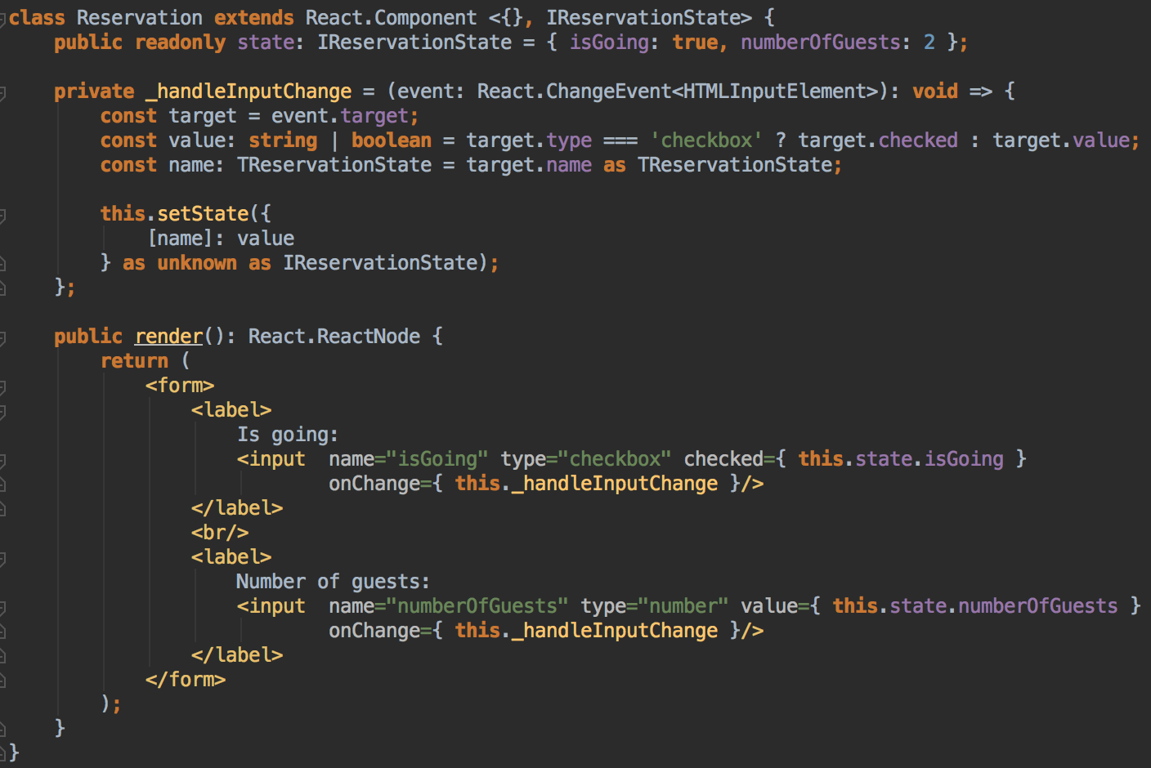
Handling Multiple Inputs
Notes:
When you need to handle multiple controlled input elements, you can add a name attribute to each element and let the handler function choose what to do based on the value of event.target.name.
Note how we used the ES6 computed property name syntax to update the state key corresponding to the given input name:

Slide 7
Refs and the DOM
Refs provide a way to access DOM nodes or React elements created in the render method.
When to Use Refs
Managing focus, text selection, or media playback.
Triggering imperative animations.
Integrating with third-party DOM libraries.
Avoid using refs for anything that can be done declaratively.
Notes:
In the typical React dataflow, props are the only way that parent components interact with their children. To modify a child, you re-render it with new props. However, there are a few cases where you need to imperatively modify a child outside of the typical dataflow. The child to be modified could be an instance of a React component, or it could be a DOM element. For both of these cases, React provides an escape hatch.

Slide 8
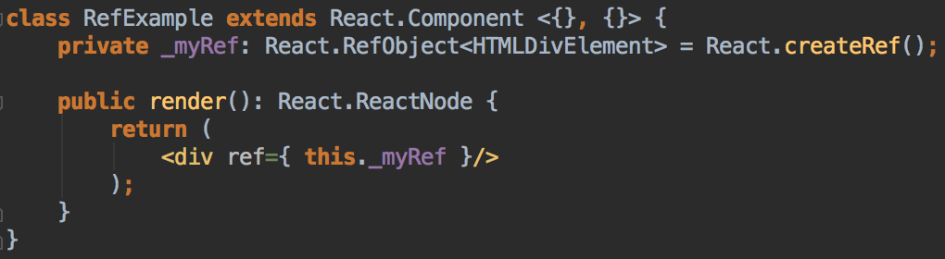
Creating Refs
Refs are created using React.createRef() and attached to React elements via the refattribute:
Notes:
Refs are created using React.createRef() and attached to React elements via the refattribute. Refs are commonly assigned to an instance property when a component is constructed so they can be referenced throughout the component.

Slide 9
Adding a Ref to a DOM Element
The value of the ref differs depending on the type of the node:
When the ref attribute is used on an HTML element, the ref created in the constructor with React.createRef() receives the underlying DOM element as its current property.
When the ref attribute is used on a custom class component, the ref object receives the mounted instance of the component as its current.
You may not use the ref attribute on function components because they don’t have instances.
Notes:
When a ref is passed to an element in render, a reference to the node becomes accessible at the current attribute of the ref.

Slide 10
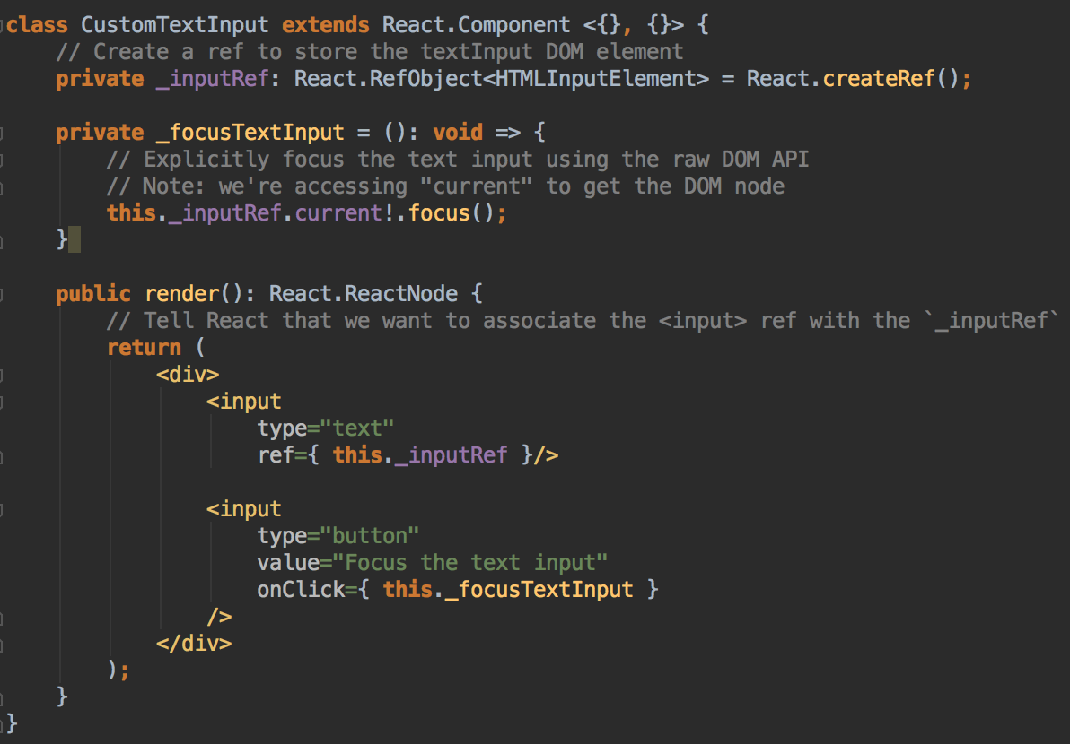
Notes:
This code uses a ref to store a reference to a DOM node. React will assign the current property with the DOM element when the component mounts, and assign it back to null when it unmounts. ref updates happen before componentDidMount or componentDidUpdate lifecycle methods.

Slide 11
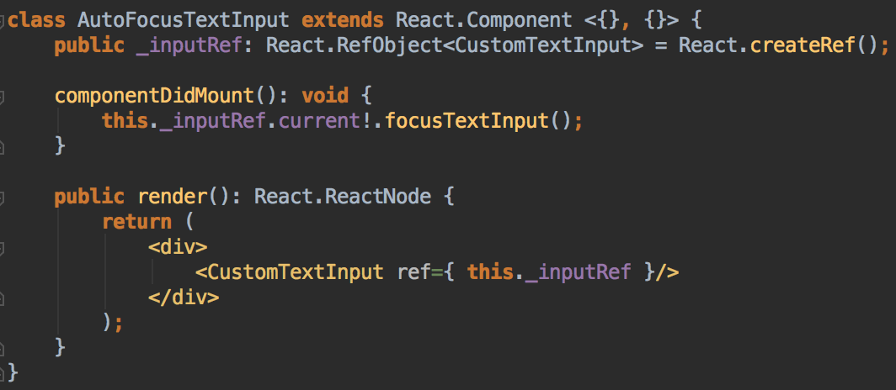
Adding a Ref to a Class Component
Notes:
If we wanted to wrap the CustomTextInput above to simulate it being clicked immediately after mounting, we could use a ref to get access to the custom input and call its focusTextInput method manually. Also focusTextInput method should be public that we will have access to it. So we have to refactor little bit.
Note that this only works if CustomTextInput is declared as a class

Slide 12
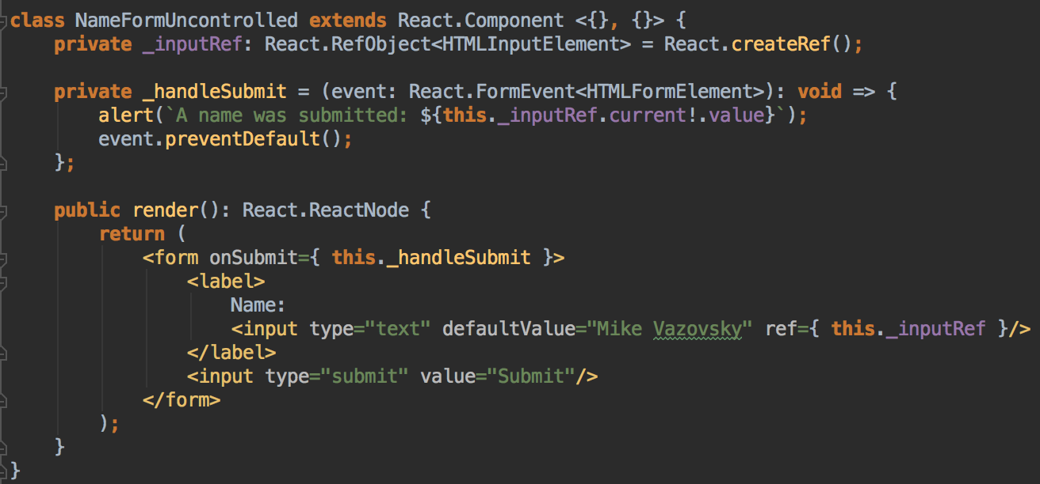
Uncontrolled Components
Notes:
In most cases, React team recommends using controlled components to implement forms. In a controlled component, form data is handled by a React component. The alternative is uncontrolled components, where form data is handled by the DOM itself.
To write an uncontrolled component, instead of writing an event handler for every state update, you can use a ref to get form values from the DOM.
Since an uncontrolled component keeps the source of truth in the DOM, it is sometimes easier to integrate React and non-React code when using uncontrolled components. It can also be slightly less code if you want to be quick and dirty. Otherwise, you should usually use controlled components.
In the React rendering lifecycle, the value attribute on form elements will override the value in the DOM. With an uncontrolled component, you often want React to specify the initial value, but leave subsequent updates uncontrolled. To handle this case, you can specify a defaultValue attribute instead of value.

Slide 13
Controlled input vs Uncontrolled
Feature | Uncontrolled | Controlled
One-time value retrieval (e.g. on submit) | + | +
Validation on submit | + | +
Instant field validation | - | +
Conditionally disabling submit button | - | +
Enforcing input format | - | +
several inputs for one piece of data | - | +
Dynamic inputs | - | +
Notes:
Both the controlled and uncontrolled form fields have their merit. Evaluate your specific situation and pick the approach — what works for you is good enough.
If your form is incredibly simple in terms of UI feedback, uncontrolled with refs is entirely fine. You don’t have to listen to what the various articles are saying is “bad.”

Slide 14
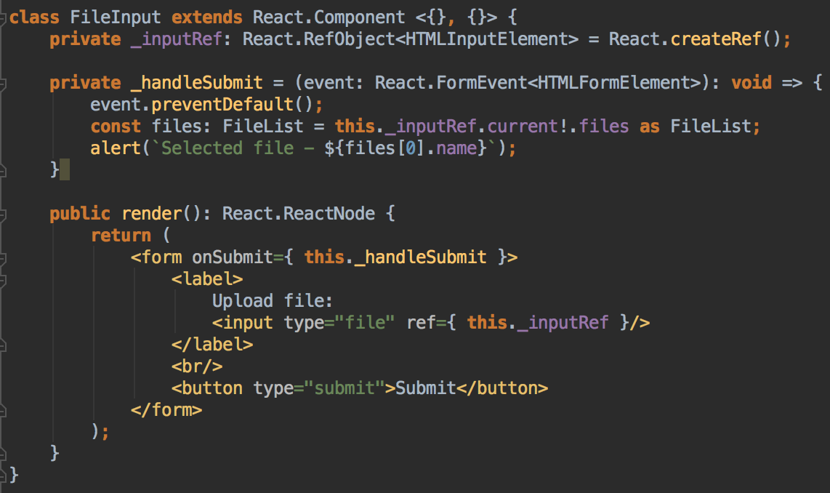
The file input Tag
Notes:
In HTML, an <input type="file"> lets the user choose one or more files from their device storage to be uploaded to a server or manipulated by JavaScript via the File API.
In React, an <input type="file" /> is always an uncontrolled component because its value can only be set by a user, and not programmatically.

